Slide 1
Module-09: Part-1: Algorithm
CS 1714 – Computer Programming II

Slide 2
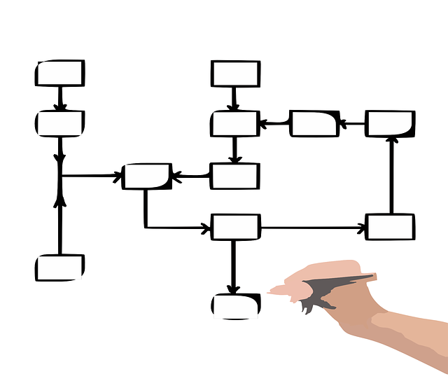
Algorithm
An algorithm is a sequence of tasks to solve a problem
There are many established algorithms in computer science for different sets of problems
For any given algorithm, the code might differ from one programmer to the next, but the rules are the same.
There may also be variations in an established algorithm.
Some are better than others!

Slide 3
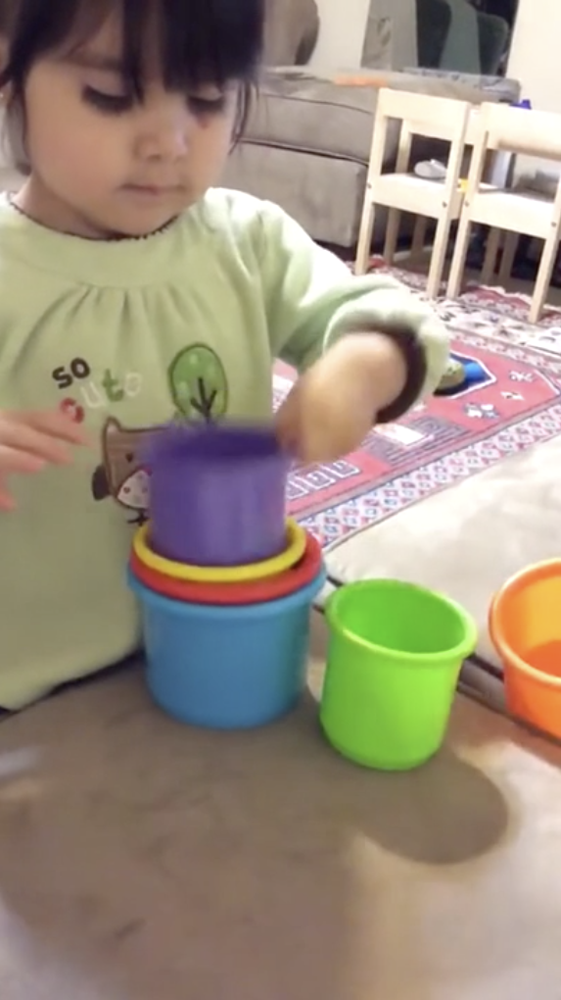
Algorithms - What’s the Problem?
Before you choose an algorithm, you need to know what the problem is.
For our class, we will be focusing on problems involving:
Computation
Searching/finding information
Traversing data structures
Sorting information (to put in order)
Click on the source link and watch the video of the child’s actions. What’s the problem the child is trying to solve?
Source: https://www.reddit.com/r/ProgrammerHumor/comments/eir3lm/me_in_cs101_writing_my_first_insertion_sort/
Notes:
NEW

Slide 4
Algorithm
Even though the code for most algorithms are widely available, you still need to know:
When it’s applicable (what type of problems)?
What is the approach to solving the problem?
What type of data is it used for?
Is it efficient (for your tasks)?
🤔
How do you adapt and integrate this code to your program?

Slide 5
Approaches to Algorithms
There are many approaches to algorithms
Greedy - solve the problem at the local level without regard for the overall context
Brute force - try all possible solutions to find the best one
Divide and conquer - divides the problem into smaller parts and then combines them together (recursion)
And many more!

Slide 6
Algorithms - What’s the Context?
When working with algorithms, we need to have some context for applying them. For example, there are several algorithms we can use with arrays to find the highest value, to find the lowest value, to sort the values in ascending order, etc.
But we still need to know more information about the arrays before we can apply an algorithm: a) What does the array contain?, b) How is it organized? since some algorithms will only work with specific types of arrays (e.g., sorted order).
0 | 1 | 2 | 3 | 4 | 5 | 6 | 7
10 | 83 | 17 | 13 | 21 | 23 | 33 | 33

Slide 7
Algorithm Efficiency
We usually discuss an algorithm’s efficiency (its ability to complete the tasks while minimizing the resources) in terms of its computational complexity.
Computational complexity describes the amount of resources it needs to complete the task:
runtime (how many operations) - T notation
memory usage (how much space is needed) - S notation

Slide 8
Run Time Efficiency
O( 1 ) | 🤩
O( log n ) | 😃
O( n ) | 😐
O( n log n ) | 😑
O( n² ) | 😡
O( 2^{n} ) | 😡😱
O( n! ) | 😡😱🤯
Big O notation is used to describe or express the upper bound complexity of an algorithm regardless of its worst/best case scenarios
Usually, we discuss this in terms of runtime complexity but can be used to describe space complexity
n represents the number of items we applying the algorithm
Graph it!

